Slide 1
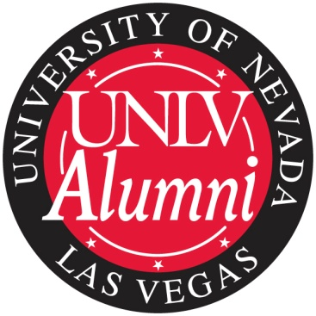
Basics of Directorship
UNLV Alumni Association
Leadership Development Day
March 5, 2011

Slide 2
UNLV Alumni Association
Began in 1968
Represent 90,000 alumni with 67% in Southern Nevada
2,800 “active” members
7 chapters, more in the works
Student Alumni Association
15 regional clubs
Promote a strong relationship between alumni and the university community
Provide volunteer leadership, support and other resources for UNLV and the association

Slide 3
Vision
We are a leader in:
Connecting alumni for life to UNLV
Communicating UNLV news to alumni
Networking for alumni, students, and prospective students

Slide 4
Structure
Volunteer Leaders
Board of Directors (26 members)
Committees
College-based Chapters (7 chapters)
Student Alumni Association
Regional & Affinity Clubs (15 clubs)
University –Paid Leaders
University Advancement
Alumni Relations (5 full-time staff)
Chapter Liaisons

Slide 5
Working Together To Engage Alumni
Advocacy – March 25 Alumni Day at Carson City
Communications
Events
Membership
Student Programs
Community Outreach
Leadership Development

